Slide 1

Securing understanding of perimeter and area
Task A: Calculating the perimeter and area of rectangles
1) Jun wants to work out the area and perimeter of each of these rectangles.
a) Which rectangles have “enough”, “too much”, or “not enough” information?
b) Find the area and perimeter of the rectangles where possible.
c) Jun works out the area of Z using the calculation 40 × 40 × 40 × 40. What have they done wrong?
40 mm
25 m
13 cm
X
13 cm
Y
6 m
40 mm
Z
40 mm
40 mm

Slide 2
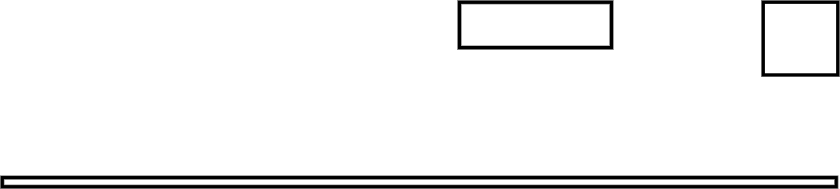
Securing understanding of perimeter and area
Task B: Identifying a rectangle from its perimeter
1) Laura wants to buy a plot of land to build a house. The table below shows some information about the plots.
Plot | Area (m²) | Perimeter (m)
X | 100 | 40
Y | 120 | 242
Z | 120 | 52
a) Which plot do you think they should choose?
By the table are plan views of the three plots.
b) Match each image to a row in the table.
c) Explain whether you wish to change your answer to part A.
Plot | Area (m²) | Perimeter (m)
X | 100 | 40
Y | 120 | 242
Z | 120 | 52
20 m
10 m
6 m
Red
10 m
Yellow
120 m
Blue

Slide 3

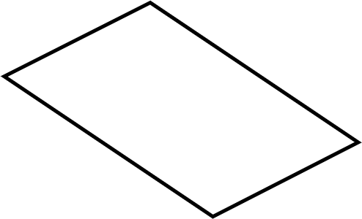
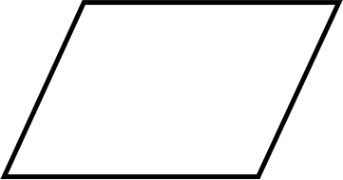
Securing understanding of perimeter and area
Task C: The area of a parallelogram
1) Calculate the area of each parallelogram.
a) b)
10 m
7.3 cm
8 cm
8 m
4 m
0.7 cm
c) The area of parallelogram is 36 units².
Calculate the size of the missing length and add it to the diagram.
12
10
Mathematics in Education and Industry.

